Slide 1
Introduction to Artificial Intelligence
Spring 2024
Bushra Rashid
Russell & Norvig: Chapter 1; Section 1.1
George F. Luger: Chapter 1

Slide 2
Grading Policy
Quiz 10
Assign 10
Mid I 15
Mid II 15
Project 10
Final 40
--------------------------
Total = 100
Note: Absolute Grading. Cut at 50.

Slide 3
Books & Resources
Text/Reference Book:
Artificial Intelligence
George F. Luger
Artificial Intelligence: A Modern Approach
Russell & Norvig
Machine Learning: Tom Mitchell (ANN-Chapter 4)
Slides will be provided through Google classroom

Slide 4
Tentative Course Outline
Introduction
State Space Search (Blind and Heuristic search)
Adversarial Search (Minimax search and Alpha-Beta pruning)
Evolutionary Search (GA)
Neural Computing (ANN)
Machine Learning
Data preprocessing (Feature engineering)
Classification
Clustering
Regression, etc.,)
Expert Systems
Deep Learning
Multi Agent Systems
Advanced Topics
Notes:
Chess, checkers, and tic-tac-toe are the three most popular games that can be solved via adversarial search

Slide 5
Applications of AI
Robotic vehicles/ Autonomous car
NLP (Speech recognition)
Search engines
Route planning
Autonomous planning and scheduling
Game playing
Spam filtering
Security and survellance (Facial recognition etc)
e-Commerce (chatbots, demand forcasting etc.)
Healthcare(personalized medicien, diagnose diseases, classification of Medical imaging etc)
Banking (Frad detection, credit decisions, etc.)
Transportation (Driver monitoring, Tarffic flow analysis, self-driving cars, etc)
Notes:
IBM Deepblue defeated world champion in chess in 1997
A Google artificial intelligence program defeated a Chinese grand master at the ancient board game. In 2017

Slide 6
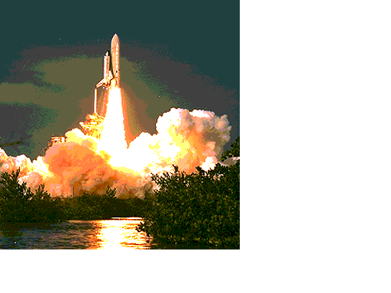
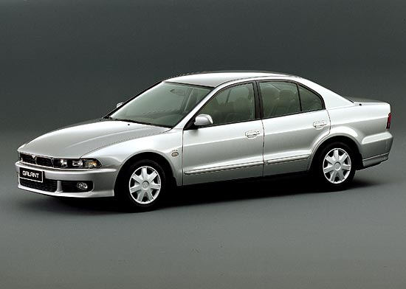
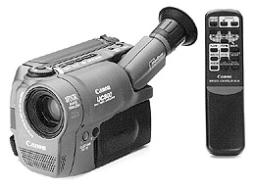
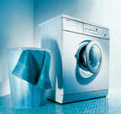
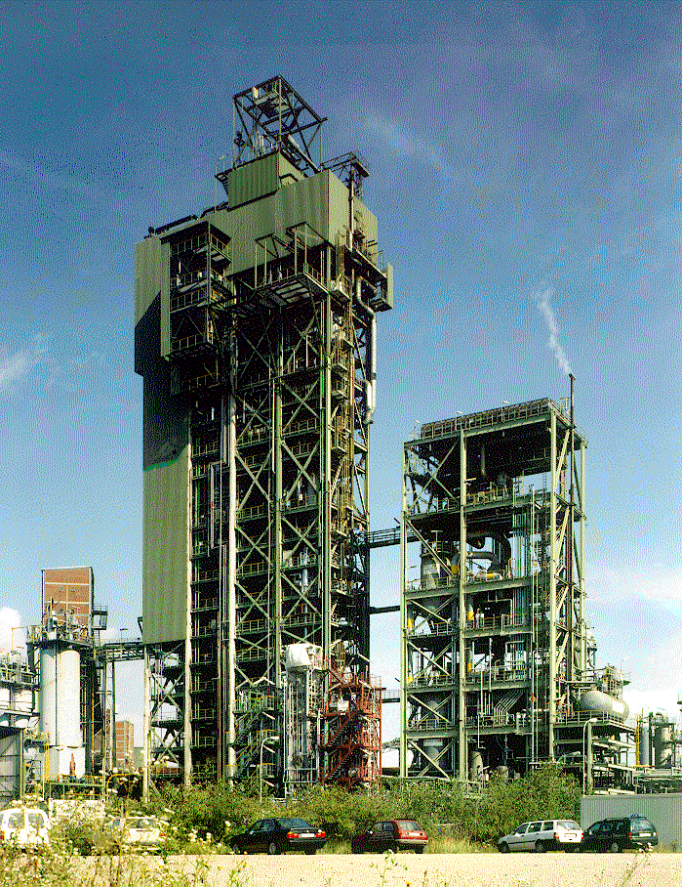
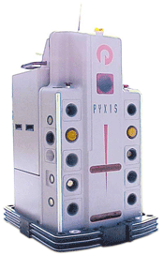
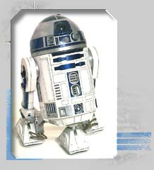
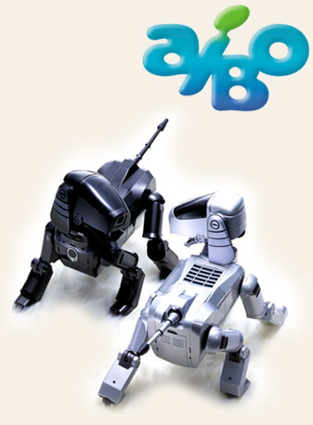
Industry 4.0 [Commercial Applications]
Heavy industry (Siemens, etc)
Home appliances (Canon, Sony, Goldstar, Siemens)
Automobiles (Tesla, Nissan, Mitsubishi, Audi, Merc, etc)
Spacecrafts (NASA)
Robotics
Notes:
Industry 4.0 refers to the “smart” and connected production systems that are designed to sense, predict, and interact with the physical world, so as to make decisions that support production in real-time. In manufacturing, it can increase productivity, energy efficiency, and sustainability.
Industry 4.0 is revolutionizing the way companies manufacture, improve and distribute their products. Manufacturers are integrating new technologies, including Internet of Things (IoT), cloud computing and analytics, and AI and machine learning into their production facilities and throughout their operations.

Slide 7
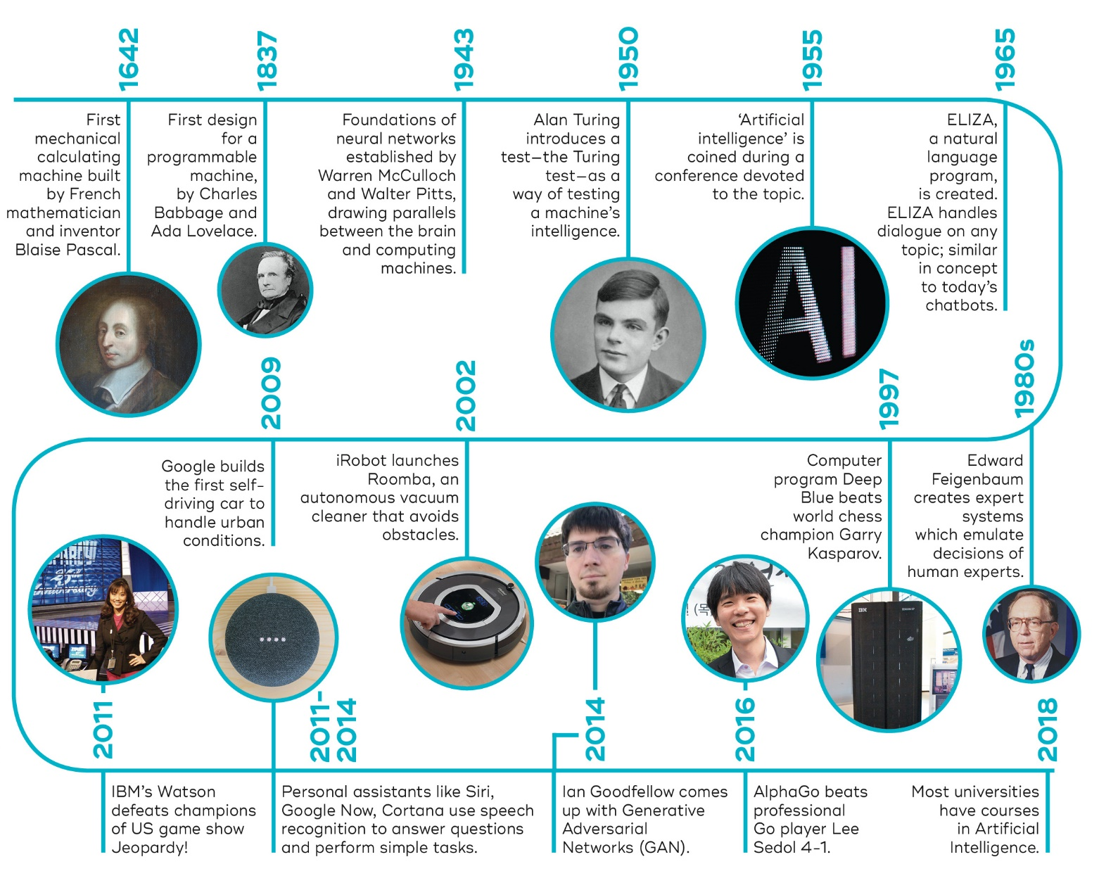
History of Artificial Intelligence

Slide 8

Demand of AI

Slide 9
Some Thought Provoking Questions
What is Intelligence?
Is it possible for a Machine to be Intelligent?
== Why can't we expect machines that can perform 100s of millions of floating-point operations per second to be able to distinguish between different kinds of objects?
== Why can't that same machine learn from experience, rather than repeating forever an explicit set of instructions generated by a human programmer?
Can machines think?
Can machines decide?
Can a machine be aware of its own existence?

Slide 10
Contd…
These are only few of the many questions facing computer designers, engineers and programmers, all of whom are striving to create more intelligent computer systems.
Some people say that we have brains that computer does not have!!!

Slide 11
What is Intelligence?
Before defining artificial intelligence, we must define intelligence.
Webster’s Dictionary Definition
The faculty of acquiring and applying knowledge.
(But what is knowledge?)
[Data, Information, Knowledge, Rules, Facts]
[Information should be accurate, relevant and timely]
The Man In The Street
Mental skill or brightness.
Trying to be more Scientific
Intelligence is a measure of the success of an entity in achieving its objectives by interaction with its environment.
Notes:
Data, Database, Data warehouse, Data mining, Big data, Data science, Data analytics, IoT, Cloud, Machine learning, Automation for Industry 4.0

Slide 12
If we accept the third definition then this has some important consequences:
Intelligent behavior can only be observed in the presence of an environment.
To measure intelligence there must be goals/objectives and a scale to determine how well these are achieved.
This definition clearly allows the possibility of intelligent machines.
The ability to "express" intelligence depends on the "richness" of interaction with the environment, and on the achievement of the goals, as well as internal mechanisms

Slide 13
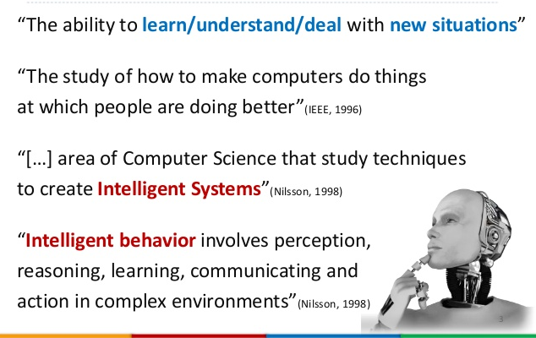
Artificial Intelligence

Slide 14
Another Definition
Artificial Intelligence may be defined as the branch of
computer science that is concerned with the
automation of intelligent behavior
An exact definition of intelligence is not easy to formulate
However, there are some general abilities which are
universally considered as intelligent

Slide 15
Another Perspective of Intelligence
According to Douglas Hofstadter these are:
- To respond to situations flexibly
If the same response is exhibited each time, the behavior is called mechanical. e.g., ATC
To survive in changing environments, one need to exhibit innovative behavior.
- To make sense out of ambiguous or contradictory messages
We understand such messages because our knowledge and experience allows us to place them in context.
NLP: e.g. time flies like an arrow
Data: e.g., Radar, Satellite and Sensor data

Slide 16
Another Perspective of Intelligence
To recognize the relative importance of different elements
of a situation
(e.g. quality versus price of a commodity)
To find similarities between situations despite differences
which may separate them
(e.g. chairs in two different pictures)
To draw distinctions between situations despite similarities
which may link them
(e.g. differences in two cars)
These abilities are largely due to knowledge and experience,
which allows you to place an information in its wider context

Slide 17
Another Perspective of Intelligence
Another definition of intelligence:
It is the ability to
- perceive inter-relationship of facts
- learn and understand from experience
- acquire and retain knowledge
- respond quickly and successfully to a new situation

Slide 18
Perceive
Communicate
Act
Retain Knowledge
Intelligence
Use
Learn
Intelligence: the ability to acquire and apply knowledge and skills.

Slide 19
Sensors
Internet of Things
Cloud
Computer Vision
NLP
Robotics
Knowledge Engineering
Knowledge Representation
How to Store, Link information we have
Big Data
Perceive
Communicate
Act
Retain Knowledge
Artificial
Intelligence
Planning
e.g., Scheduling
Problem Solving
Searching for solution e.g., game playing
Decision Making
Complex or simple
Uncertain and Certain situations
Data Mining
Data Science
Reasoning
use the stored information to answer questions and to draw new conclusions
Use
Knowledge
Learn
MACHINE LEARNING
Supervised Learning
Unsupervised Learning,
Semi-supervised Learning, Reinforcement Learning
Deep Learning

Slide 20
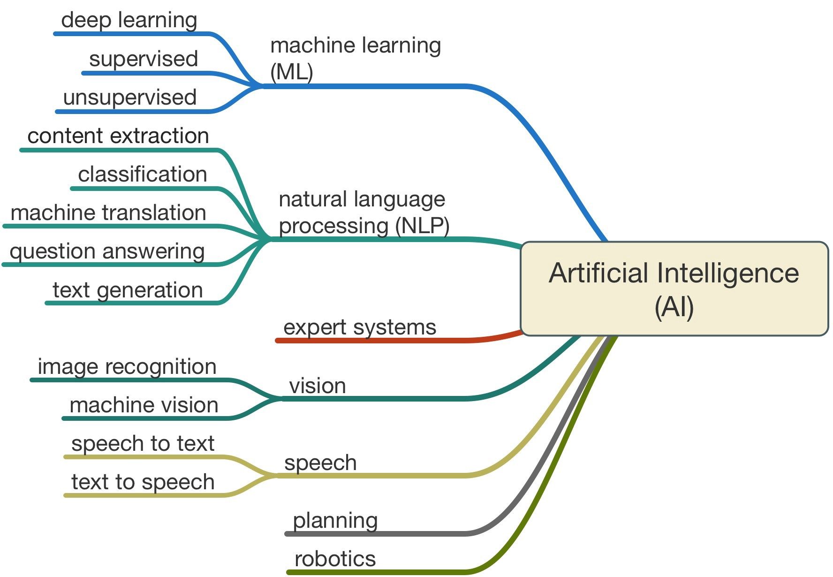

Slide 21
Reasoning
It is fair to say that to be intelligent requires two things:
a) Knowledge
b) Reasoning skills
Intelligent behavior implies the linking of these two together and hence being able to deduce facts that are not explicit in the Knowledge and produce sensible reactions to these facts.
In human beings, there is a consciousness that enables us to understand concepts such as what and why, that is intentionality.
With this ability we are able to make reasoned judgments and act accordingly.
Of course the "reason" within our decisions is often subjective (and in the same way, our definition of intelligent behavior is largely subjective). So what forms of reasoning are there? Here are the three main types:
Deduction
Abduction
Induction
We shall now go through these in more detail.

Slide 22
Deduction
A, A=>B conclude B
This is read as: A is true. If A is true then B is true. Therefore conclude that B is true
Example:
I hit the glass with a hammer Hitting a glass with a hammer => glass breaks Conclude: The glass is broken
This can also work backwards in the negative sense: ~B, A=>B conclude ~A (B is not true. If A is true then B is true. As B is not true then A cannot be true either)
Example
The glass is not broken Hitting a glass with a hammer => glass breaks Conclude: I didn't hit the glass with a hammer
This is a sound form of reasoning. Given that proposition A is true and that the truth of proposition B is based only on whether A is true or not, B can be very reliably inferred from the truth or otherwise of A.

Slide 23
Abduction
B, A=>B conclude A
This is read as: B is true. If A is true then B is true. Therefore conclude that A is true.
Taking the previous example this states:
The glass is broken Hitting a glass with a hammer => glass breaks Conclude: I hit the glass with a hammer
This is a reasonable deduction but not necessarily true. Someone else may have hit the glass with a hammer or maybe I threw the glass onto the floor.
This is "jumping to conclusions" which is not sound though we do it all the time.
There are many situations where more than one reason for something happening could be true and we have to choose the most likely one.
In other words, we perform "informed guesswork"!

Slide 24
Induction
A E S ^ red(A) D E S ^ red(D) F E S ^ red(F) Conclude: For all x where x is an element of set S x is red
These read as: A is an element of the set S and A is red, D is an element of the set S and D is red, F is an element of the set S and F is red.
Example: (Fred, Derek and Charles are all men.) Fred is a man and Fred is TALL. Derek is a man and Derek is TALL. Charles is a man and Charles is TALL. Conclude from the three examples: All men are TALL.
This is not sound. Making such a deduction from so small a sample is statistically unsound yet we do this all the time too!
Induction is only safe if it is statistically sound, that is, there is a sufficiently large sample and that set of samples is truly randomly selected.

Slide 25
The Need for Structured Knowledge Representation
The second requirement for intelligent behavior is the knowledge itself.
So all we do is stuff some facts into a computer system, put a reasoning program into action and we can have an intelligent machine!
Well it's not quite that simple.
Many A.I. structures show themselves to work well in simple "toy" domains but once they are presented with real world domain problems they suddenly begin to collapse.
The problem is that they don't have enough knowledge about the domain and so can't respond to it.
If we attempt to simply solve this problem by stuffing more information into the system we quickly come across the problem of speed. The specific piece of information in the database of knowledge cannot be accessed fast enough for a reasonable response using simple search techniques.
One of the major keys to AI then is being able to store knowledge in an efficient fashion and in such a way that it is possible to compose programs that can access it in a reasonable time.

Slide 26
The Frame Problem
For any situation it's difficult to predict in advance exactly what knowledge you'll need, that is knowledge that's relevant to a given problem; this is known as the frame problem.
Consider the simple case of the representation of a bird, as Minsky says:
Let's take a very simple fact like all birds can fly. Well that's true in a certain dictionary context but it's not true of all birds, so if you try to put this information in a rule based system you'd have a little trouble. First you'd have to say if Tweetie is a bird it can fly unless it is an ostrich or unless it's a penguin so now you're starting to get exceptions. Then somebody might say "What if you clipped its feathers?" and you'd say "If something is a bird and it has normal feathers and it is not an ostrich or a penguin then it can fly". Then someone might say "Well what if it's dead?" so you'd reply "If it's ... and it's not dead then it can fly." Someone else might say "What if it's in a cage?", "What if it got its feet stuck in concrete?".

Slide 27
The Frame Problem
You see it's almost impossible to think of any fact about the real world that's true.
As you can see it seems to go on and on forever, "What's concrete?" It's difficult to know where to stop.
Ideally we would represent all the knowledge in the world that everybody knows, but to do this would result in an enormous data structure. It would be absolutely vast and the access time would be enormously slow.
The upshot is that we don't know how to build such a structure and how to index it rapidly. What is more, we don't know how to acquire all the knowledge.
A number of methods have been proposed for representing knowledge some more appropriate in certain situations than others but none ideal. These include first order predicate calculus, semantic nets, conceptual graphs, frames, scripts and rules (which shall lead us onto Expert Systems).

Slide 28
Some definitions of AI
Act like human
Think like human
Act Rationally
Think rationally

Slide 29
Act Like Human
“The study of how to make computers do things at which, at the moment, people are better. (Rich and Knight, 1991)
Turing Test:
A computer passes the test if a human interrogator, after posing some written questions, cannot tell whether the written responses come from a person or from a computer.
Required Capabilities to pass Turing Test:
Natural Language Processing (NLP)
Knowledge Representation
Automated Reasoning
Machine Learning
Computer Vision
Robotics
These six disciplines compose most of AI. Yet AI researchers have devoted little effort to passing the Turing Test, believing that it is more important to study the underlying principles of intelligence than to duplicate an exemplar.

Slide 30
THINK LIKE HUMANS
Aeronautical engineering texts do not define the goal of their field as making “machines that fly so exactly like pigeons that they can fool even other pigeons”
“[The automation of] activities that we associate with human thinking, activities such as decision-making, problem solving, learning ...” (Bellman, 1978)
Not to merely solve the problem correctly but also the steps used to solve it.
Cognitive Science
Notes:
Cognitive skills: Perception, attention, processing, logic and reasoing

Slide 31
THINKING RATIONALLY: The “laws of thought” approach
The study of the computations that make it possible to perceive, reason, and act (Winston, 1992)
Irrefutable reasoning processes
E.g., Algorithm/planning for a robotic arm

Slide 32
THINKING RATIONALLY: The “laws of thought” approach
The study of the computations that make it possible to perceive, reason, and act (Winston, 1992)
Irrefutable reasoning processes
E.g., Algorithm/planning for a robotic arm
This aspect refers to developing AI systems that utilize formal rules of logic to reach conclusions. This involves creating systems that can perform tasks that require formal reasoning and deduction. Examples include:
• Expert systems that use rule-based reasoning to diagnose medical conditions or provide legal advice.
• Automated theorem proving systems that prove mathematical theorems based on logical axioms.

Slide 33
THINKING RATIONALLY: The “laws of thought” approach
Right Thinking – Aristotle
• Socrates is a man, all men are mortal; so, Socrates is mortal
• Logic
• Law of thoughts were supposed to govern the operation of mind
• It is not easy to take informal knowledge and state in the formal term

Slide 34
ACTING RATIONALLY: The rational Agent approach
A rational agent is one that acts so as to achieve the best outcome or, when there is uncertainty, the best expected outcome
All the skills needed for the Turing Test also allow an agent to act rationally.
Advantages over other approaches
More general than the “laws of thought”
Mathematically well defined
Requires reasoning abilities
Knowledge representation and reasoning enables agents to reach good decisions
Note: Perfect rationality not feasible due to high computation cost
Notes:
Making correct inferences is sometimes part of being a rational agent, because one way to act rationally is to reason logically to the conclusion that a given action will achieve one’s goals and then to act on that conclusion.

Slide 35
Designing of an AI control Algorithm for a Robot Arm
Blocks
c
b
Robotic Arm
a
d
Fixed Base
Objective:
To model the block’s world shown in the figure above to design a control algorithm for a robotic arm.
Assumptions:
The computer has knowledge of the locations of the blocks (may be in the form of three dimensional coordinates).
It is able to keep track of these locations as the hand moves about the table.

Slide 36
Designing of an AI control Algorithm for a Robot Arm
Predicate Calculus Description of the Block’s World
on(c,a). Block ‘c’ is ‘on’ block ‘a’
on(b,d). Block ‘b’ is ‘on’ block ‘d’
ontable(a). Block ‘a’ is on table
ontable(d). Block ‘d’ is on table
clear(c). Block ‘c’ is clear on top
clear(b). Block ‘b’ is clear on top
hand_empty. Robot arm is empty
Predicate Calculus Rules to Operate on the Block’s World
To pick up a block and stack it on another block, both blocks must be clear.
Because the arm can move blocks, it can change the state of the world and clear a block.
Suppose it removes block ‘c’ from block ‘a’. Thus the knowledge base is updated to reflect this, by deleting the assertion on(c,a).

Slide 37
Designing of an AI control Algorithm for a Robot Arm
Predicate Calculus Rules to Operate on the Block’s World
The program needs to be able to infer that the block ‘a’ has become clear.
The following rule describes when a block is clear”
∀X (~ ∃ Y on(Y,X) a clear(X)).
For all X, X is clear, if there does not exist a Y such that Y is on X.
This rule not only defines ‘what it means for block to be clear’, but also provides a basis for determining ‘how to clear blocks that are not’.
For example, “block d is not clear”:
Because if variable X is give value d, substituting ‘b’ for Y will make the statement false.
Therefore, to make this definition true, block ‘b’ must be removed from block ‘d’.
This is easily done because the computer has a record of all the blcoks and their locations.

Slide 38
Designing of an AI control Algorithm for
a Robot Arm
Predicate Calculus Rules to Operate on the Block’s World
Other rules such as describing the operation of stacking one block on another can also be defined.
For example: to stack X on Y, first empty the hand, then clear Y and then pick up X and put won X on Y.
∀X ∀Y (hand_empty ^ clear(X) ^ clear(Y)
^ pick_up(X) ^ put_down(X,Y)
a stack(X,Y) ).
It must be noted that in implementation of the above description, it is necessary to “attach” an action of the robot arm to each predicate such as pick_up(X).

